Slide 1
Graph Groups
Using Parallel ( openMP API)

Slide 2
TABLE OF CONTENTS
01
03
Overview Algorithm
Algorithm Of Sequential Code
02
Algorithm Of parallel Code

Slide 3
Algorthim Implementation Steps
Step 1
Step 2
Step 3
Write Pseudocode for Algorithm
Sequential Code
Parallel Code (replace break by continue and shared flag)
Step 4
Step 5
Step 6
Search about and try to use omp directives and clauses
Use atomic and critical
Merge the separated two parallel for loops with nested parallel for loop(to improve performance)

Slide 4
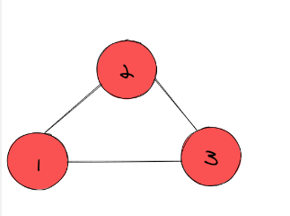
Overview Algorithm
Algorithm Name: Graph Grouping:
graph G = (V,E), where V = {1, ..., n} and |E| = m, find all groups of nodes reachable from any node within same group.

Slide 5
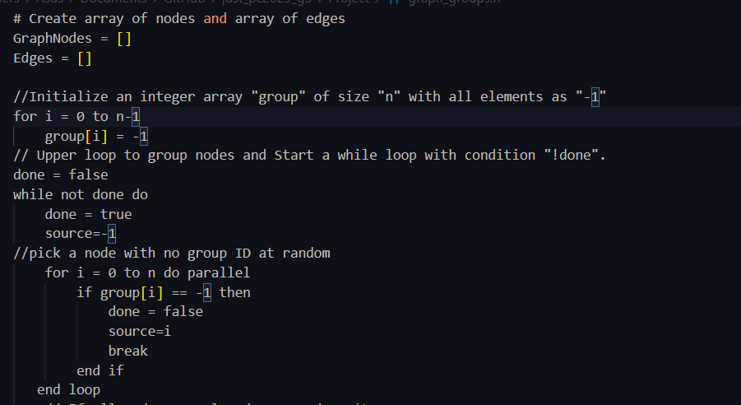
Pseudocode upper loop

Slide 6
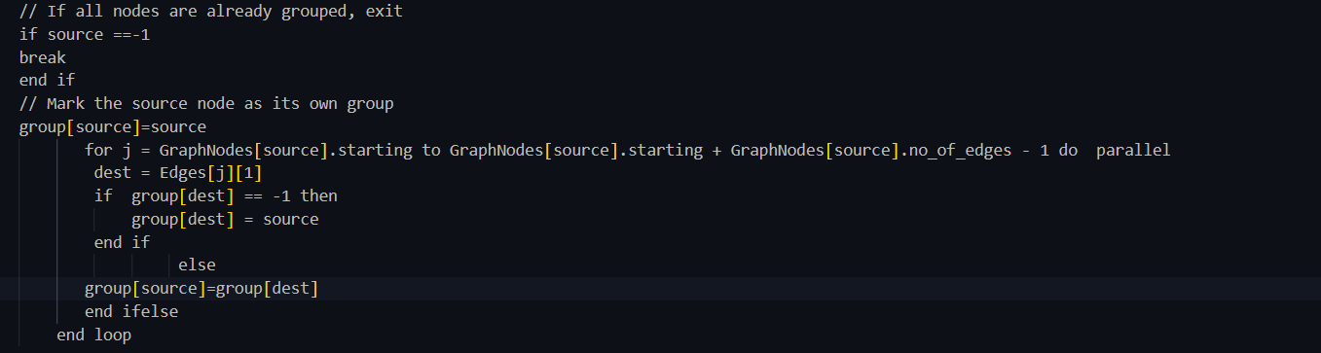
Pseudocode loop 2
Pseudocode upper loop

Slide 7
01
Algorithm Of Sequential Code

Slide 8
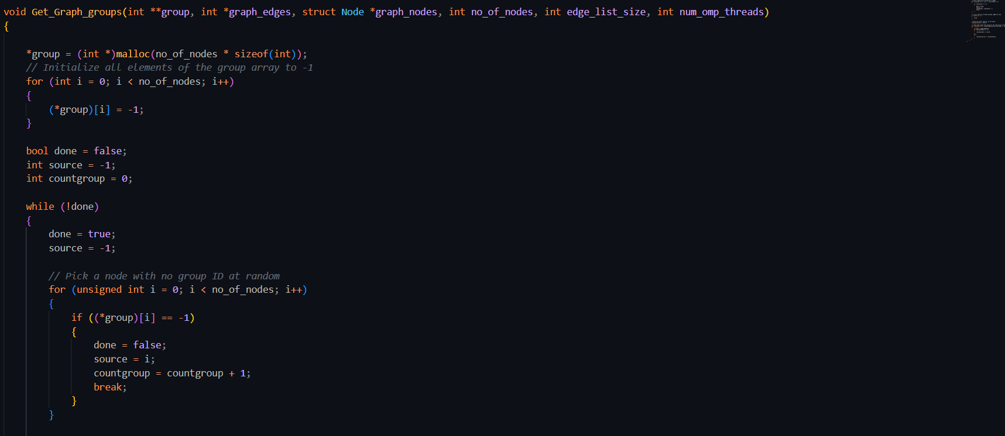
Step 1:

Slide 9
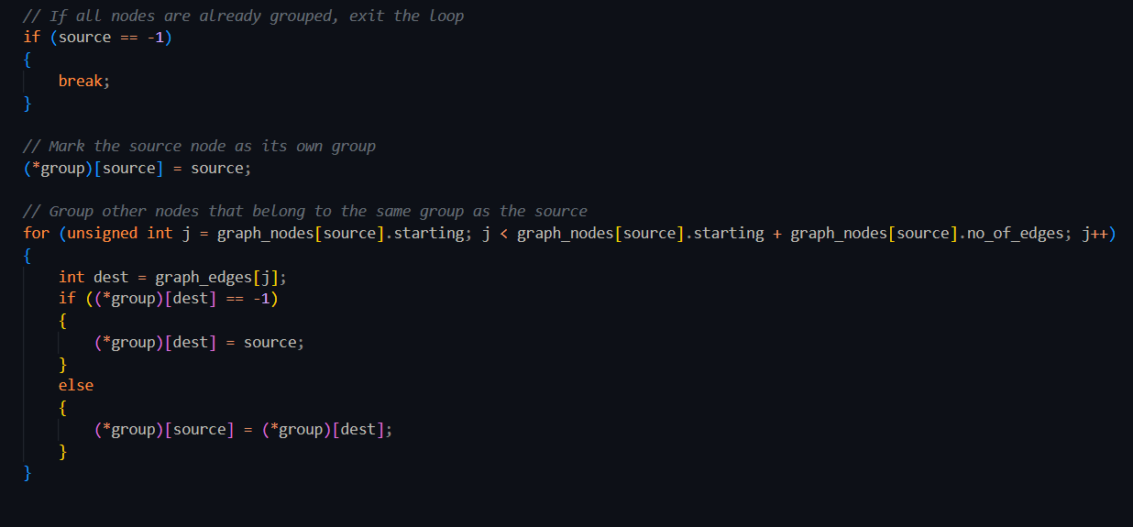
Step 2:

Slide 10
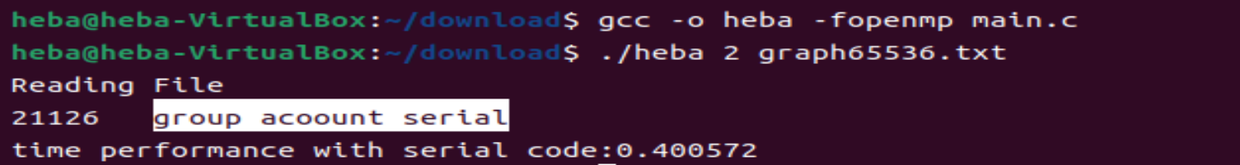
Result Of serial code : sample file :graph65536.txt
21126
Count of group :
0.400572
Time in second :

Slide 11
device specifications
Core I5 G12
VIRTISUAL MACHINE 8 : UBUNTUE 22.0

Slide 12
CHALLENGE

Slide 13
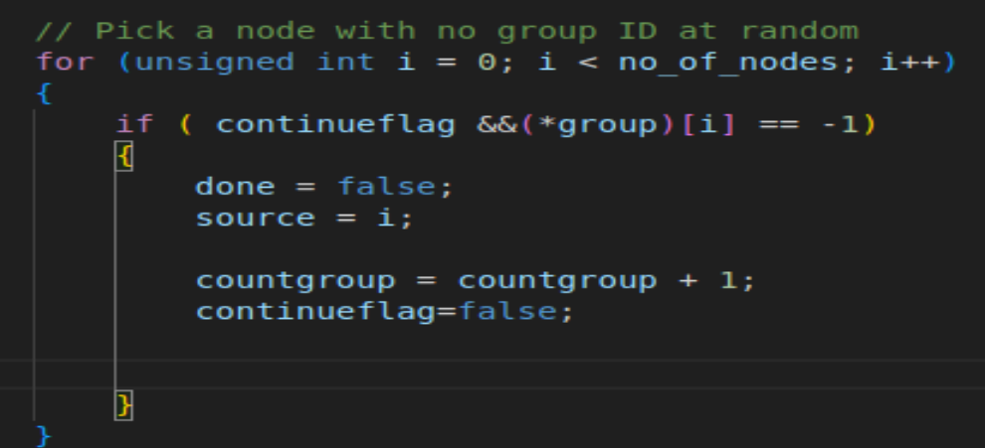
Not allowed to use break.
The "pragma omp parallel" directive distributes work between parallel threads and executes a parallel block on each thread. Since threads run synchronously, using "break" inside a parallel block will affect the execution of other threads and may cause undefined behavior or program hangs.
Solution: 1.decleare continue flag 2.assign false 3.replace break to flag continue ->false break ->true.

Slide 14
Main Challenge

Slide 15
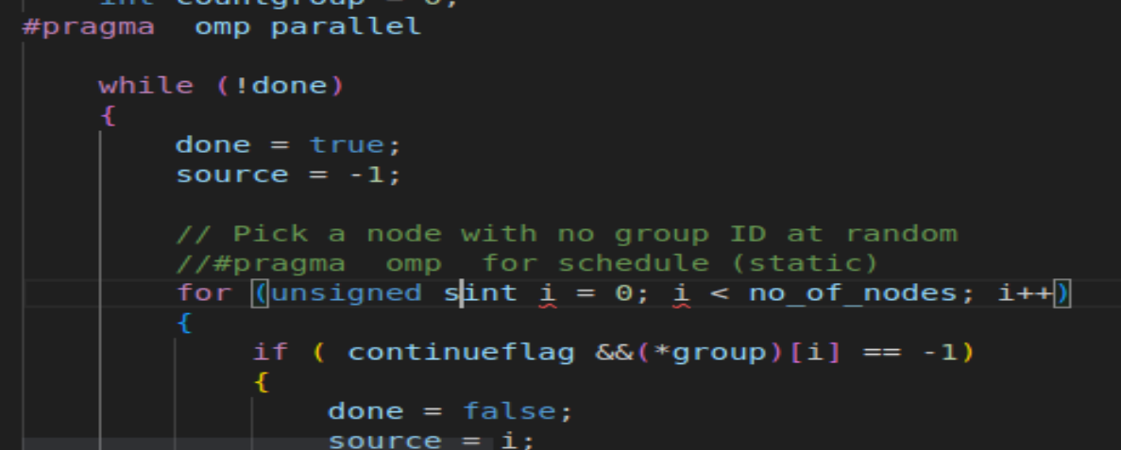
Step 1 : defines the parallelism
1.#pragma omp parallel defines the parallelism area and assigns parallel threads to execute the following code. The work is automatically distributed to the parallel threads.

Slide 16
Step 1 challenge : Achieving balance in the division of labor between parallel threads:
1.
1.Divide the material into equal parts and give to each thread. This method is effective, as they work on fragmented areas equally, but the performance is bad.

Slide 17
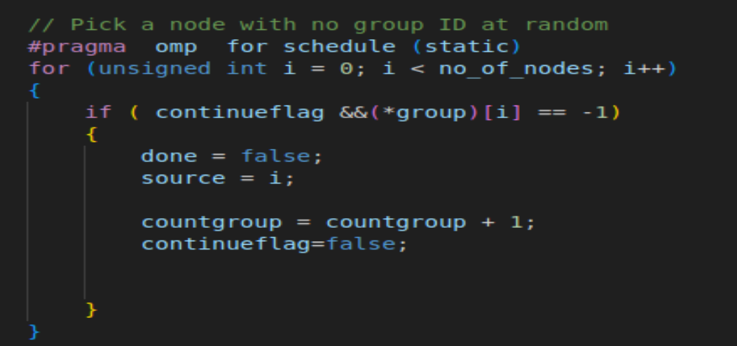
Solution :

Slide 18
Solution #pragma omp for schedule()
 | performance
Static | 0.923191
Dynamic | 9.359753 use two loop dynamic bad performance | if you use Dynamic Scheduling in OpenMP and set the Chunk Size to a large value, some threads may delay execution because they are waiting for other threads to finish their work units.use chunk size =10 increase performance 3.355
Guided | 1.08922

Slide 19
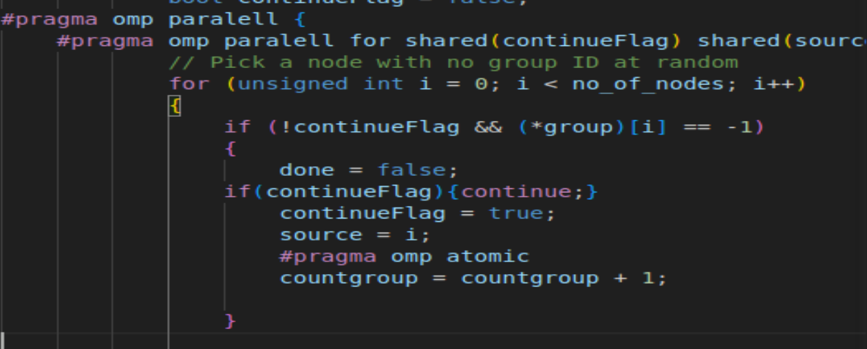
Step 2 :with parallel for with schedule and shared variable vs private .
Step 2 :with parallel for

Slide 20
PERFORMANCE For Group65536 File
 | One Thread | Two Thread | Three Thread | Four Thread
Parallel Code | 0.90212 | 0.9073 | 0.9026 | 0.8793
Atomic with separated loops | 1.0212 | 0.901844 | 0.94776 | 0.92678
Atomic with nested loops | 0.0017 | 0.00155 | 0.001602 | 0.001721
Add Schedule (dynamic) for parallel | 0.001432 | 0.015035 | 0.001789 | 0.002195
Number of the groups is 21126
The Average of Sequential code is 0.998945

Slide 21
PERFORMANCE For Group1MW_6 File
 | One Thread | Two Thread | Three Thread | Four Thread
Parallel Code | 117.02 | 110.83 | 113.485 | 114.567
Atomic with nested loops | 0.045733 | 0.057854 | 0.059707 | 0.059707
Add Schedule (dynamic) for parallel | 0.042726 | 0.041647 | 0.042191 | 0.041736
Number of the groups is 326558
The Average of Sequential code is 287.076

